Slide 1
Data acquisition & IOT enabled weather monitoring/forecasting system
MINI PROJECT - 1

Slide 2
Members
Bathina Anudeep
Naveen Nischal
Nikhil Kumar
Shaik Mastan Shariff

Slide 3
Literature survey

Slide 4
Objective
The objective of the project is to collect the data(weather) from sensors through microcontroller and send the information to the cloud and try to access it anywhere from the world.

Slide 5
Materials
Nodemcu Esp8266
DHT11-temperature & humidity
MQ05-Gas sensor
Rain drop sensor
Blynk

Slide 6
WORKFLOW

Slide 7
Collecting the data from sensors through Node mcu
The data sent will be received in our cloud platform : Blynk
The future data will predicted using the recorded data
Data acquisition
Sending data
Receiving data
Accessing data
Prediction
The data collected at Nodemcu will be sent to the cloud using WIFI protocol
The data will be accessed through phone app blynk anywhere from the world

Slide 8
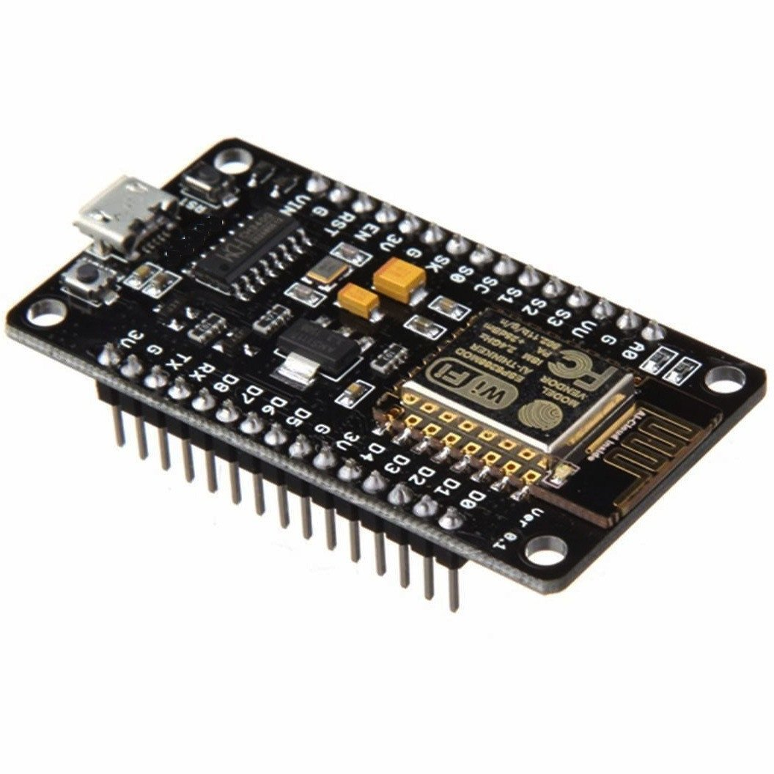
Nodemcu
NodeMCU is an open source development board and firmware based in the widely used ESP8266 wifi module.
Can be programmed with the simple and powerful Lua programming language or Arduino IDE.

Slide 9
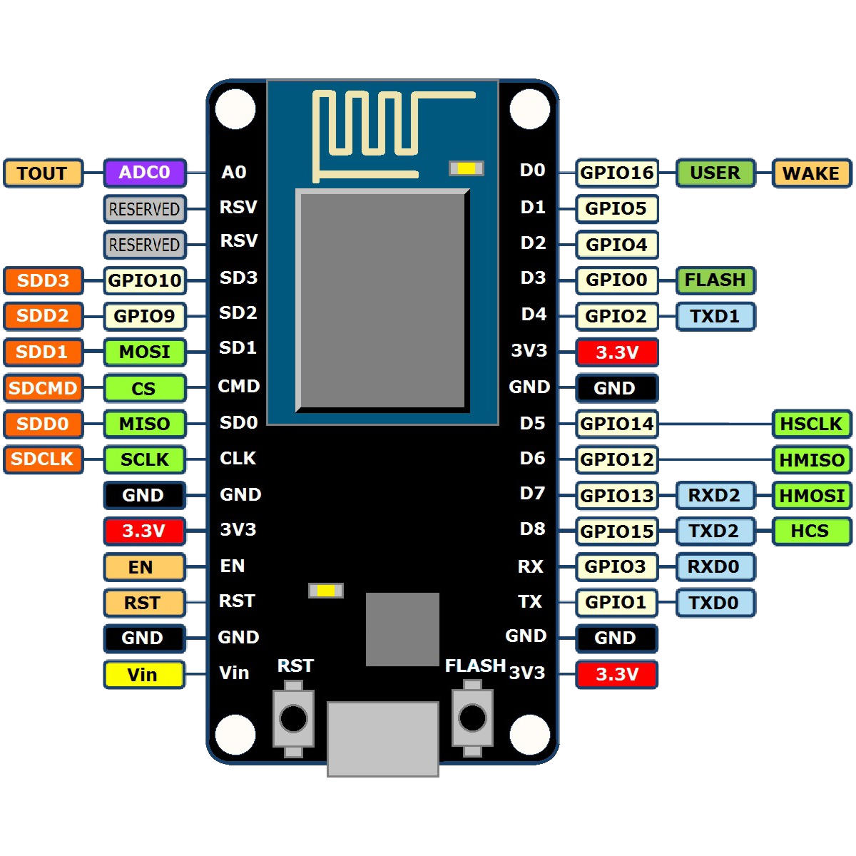
Pin configuration

Slide 10
Specifications
&
Features
Microcontroller: Tensilica 32-bit RISC CPU Xtensa LX106
Operating Voltage: 3.3V
Input Voltage: 7-12V
Digital I/O Pins (DIO): 16
Analog Input Pins (ADC): 1
UARTs: 1
SPIs: 1
I2Cs: 1
Flash Memory: 4 MB
SRAM: 64 KB
Clock Speed: 80 MHz
USB-TTL based on CP2102 is included onboard, Enabling Plug n Play
PCB Antenna
Small Sized module to fit smartly inside your IoT projects

Slide 11
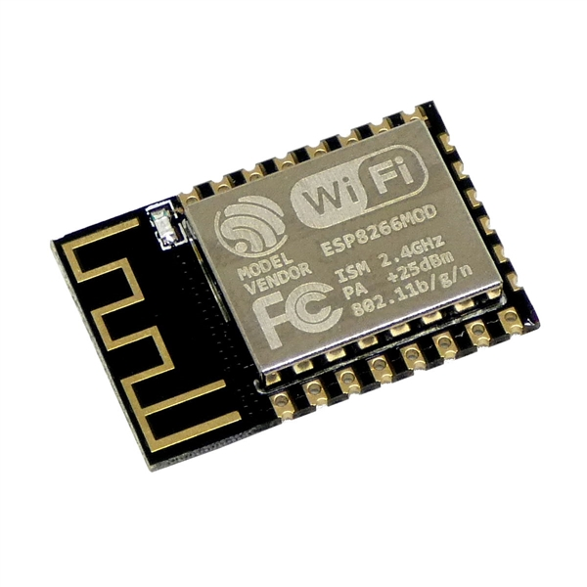
ESP8266 WIFI MODULE
The built in wifi module enables us to use its key features to connect it to the cloud .
Features:
1.Antenna operates at 2.4GHz frequency
2.Integrated TCP/IP protocol stack.

Slide 12
Arduino IDE programming
//including libraries
//global variables
void setup()
{
// put your setup code here, to run once:
//all pin configurations are done here
}
void loop()
{
// put your main code here, to run repeatedly:
//It mainly involves the coding part for the sensors & actuators
}

Slide 13
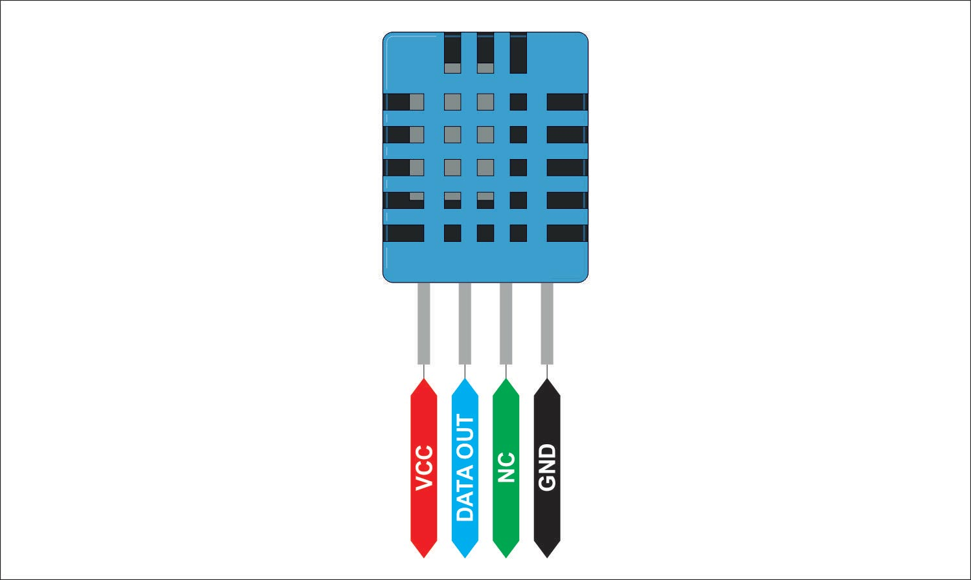
DHT11
DHT11 sensor gives humidity & temperature data.
The DHT11 is chosen because it is calibrated , accurate and stable and its single output is digital.

Slide 14
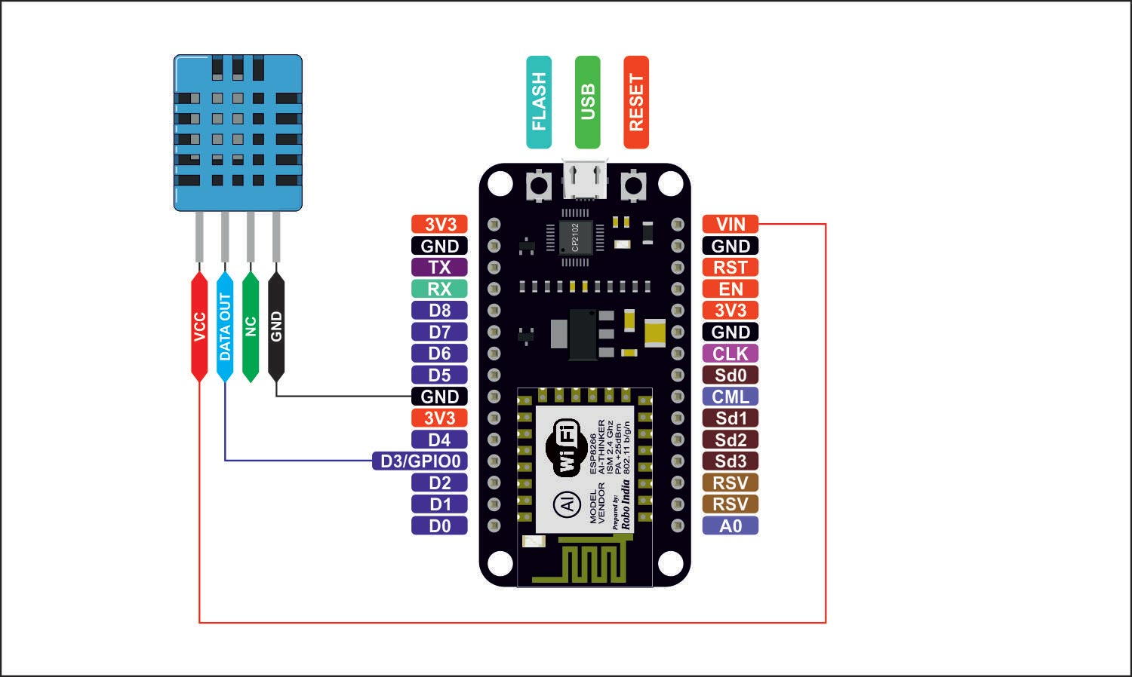
Pin interfacing

Slide 15
Data acquisition from DHT11
#include "DHT.h" // including the library of DHT11 temperature and humidity sensor
#define DHTTYPE DHT11 // DHT 11
#define dht_dpin 0
DHT dht(dht_dpin, DHTTYPE);
void setup(void)
{
dht.begin();
Serial.begin(9600);
Serial.println("Humidity and temperature\n\n");
delay(700);
}
void loop() {
float h = dht.readHumidity();
float t = dht.readTemperature();
Serial.print("Current humidity = ");
Serial.print(h);
Serial.print("% ");
Serial.print("temperature = ");
Serial.print(t);
Serial.println("C ");
delay(800);
}

Slide 16
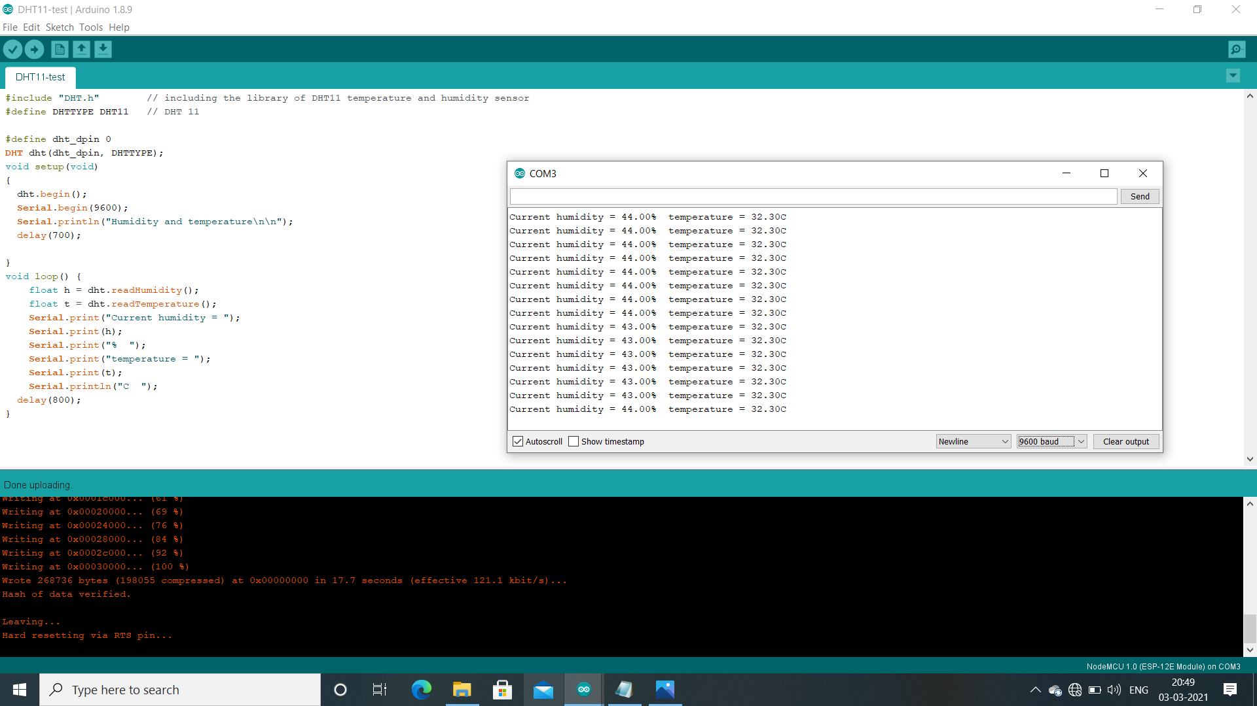
OUTPUT OBSERVED

Slide 17
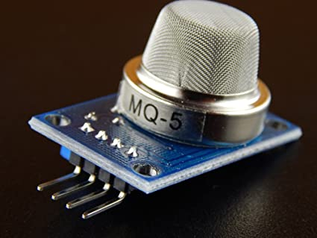
MQ05
It is also called as smoke sensor.
They are used in gas leakage detecting equipments in family , industry and forest , are suitable for detecting of smoke , LPG, natural gas , town gas.

Slide 18
Data acquisition from MQ05
define MQpin A0 //MQ module pin is connected to analog pin A0 of NodeMCU
void setup() //This executes only once in a Program Execution
{
pinMode(MQpin, INPUT); //MQ pin has made input in NodeMCU
Serial.begin(115200); //Serial Monitor starts with 115200 buad rate
}
void loop()
{
float MQvoltage = (analogRead(MQpin) * (5.00 / 1023)); //To calculate the voltage read from ADC
Serial.print("MQ - 05 Sensor = ");
Serial.print(MQvoltage); //Printing the voltage value
Serial.println("Volts");
delay(1000); //Delay of 1 second
}

Slide 19
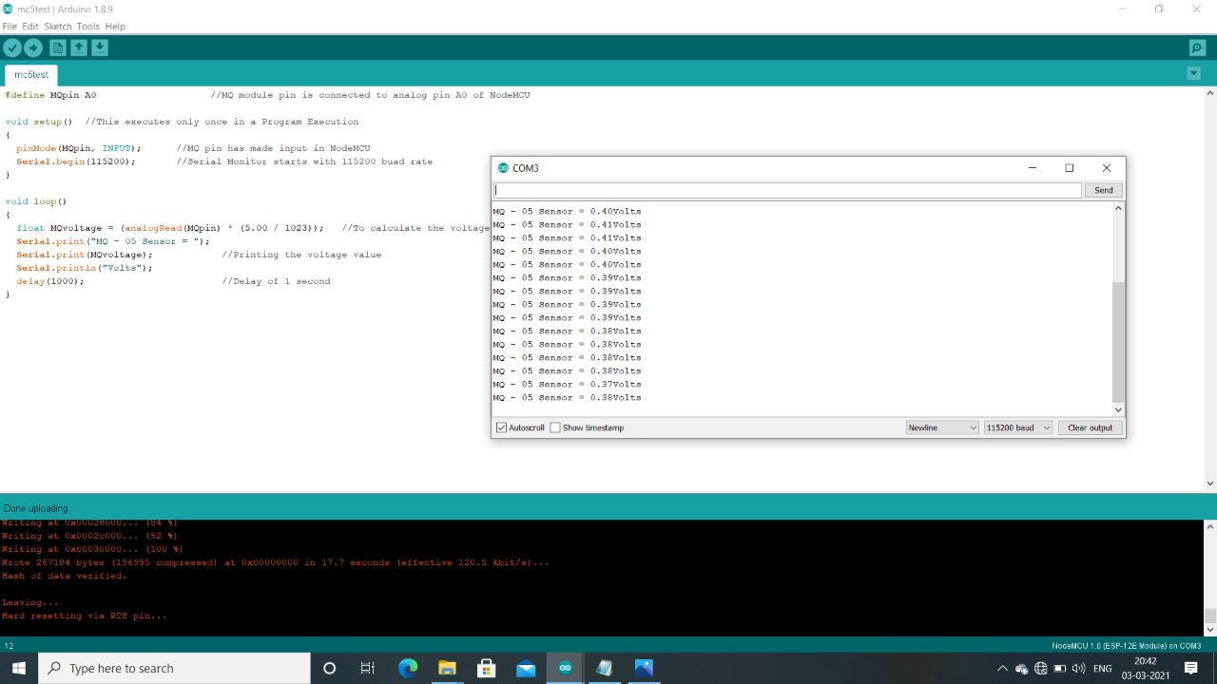
OUTPUT OBSERVED

Slide 20
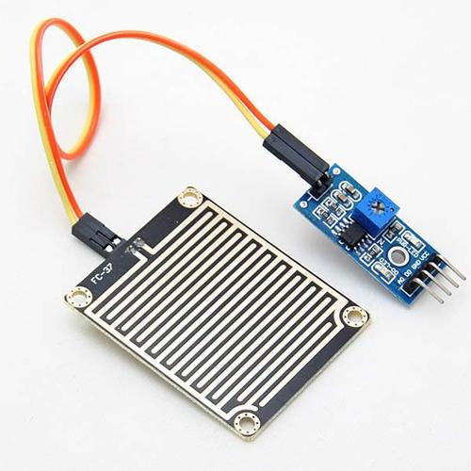
Rain Sensor
Raindrop Sensor is a tool used for sensing rain. It consists of two modules, a rain board that detects the rain and a control module, which compares the analog value, and converts it to a digital value

Slide 21
Data acquisition from rain sensor
int sensorPin = A0; // input for LDR and rain sensor
int enable2 = 13; // enable reading Rain sensor
int sensorValue2 = 0; // variable to store the value coming from sensor Rain sensor
void setup()
{ // declare the enable and ledPin as a
pinMode(enable2, OUTPUT);
Serial.begin(115200);
}
void loop()
{//--------------------------Rain Sensor-------------------------
delay(500);
sensorValue2 = analogRead(sensorPin);
sensorValue2 = constrain(sensorValue2, 150, 440);
sensorValue2 = map(sensorValue2, 150, 440, 1023, 0);
if (sensorValue2>= 20)
{
Serial.print("rain is detected");
digitalWrite(enable2, HIGH);
}
else
{
Serial.print("rain not detected");
digitalWrite(enable2, LOW);
}
//Serial.print("Rain value: ");
//Serial.println(sensorValue2);
Serial.println();
delay(100);
}

Slide 22
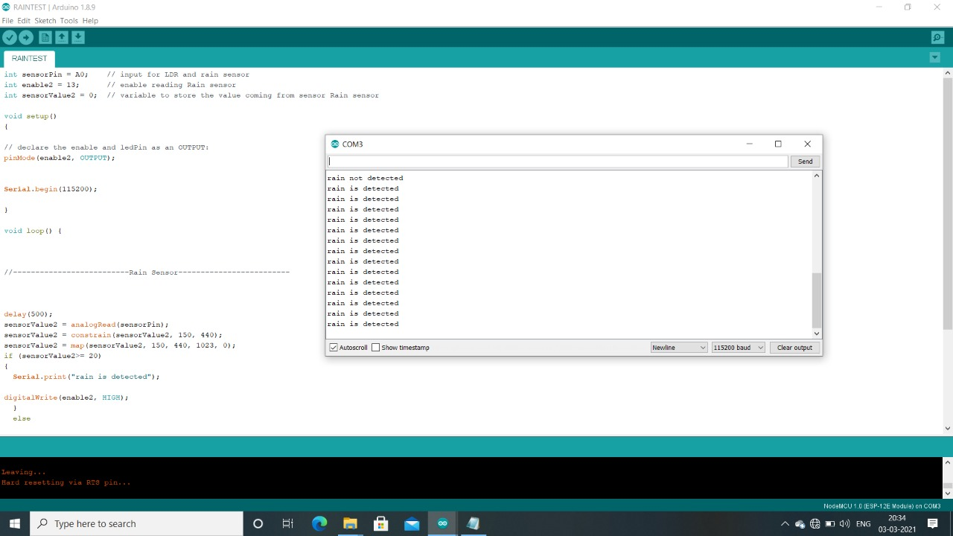
OUTPUT OBSERVED

Slide 23
CONNECTING 2 SENSORS AT A TIME:

Slide 24
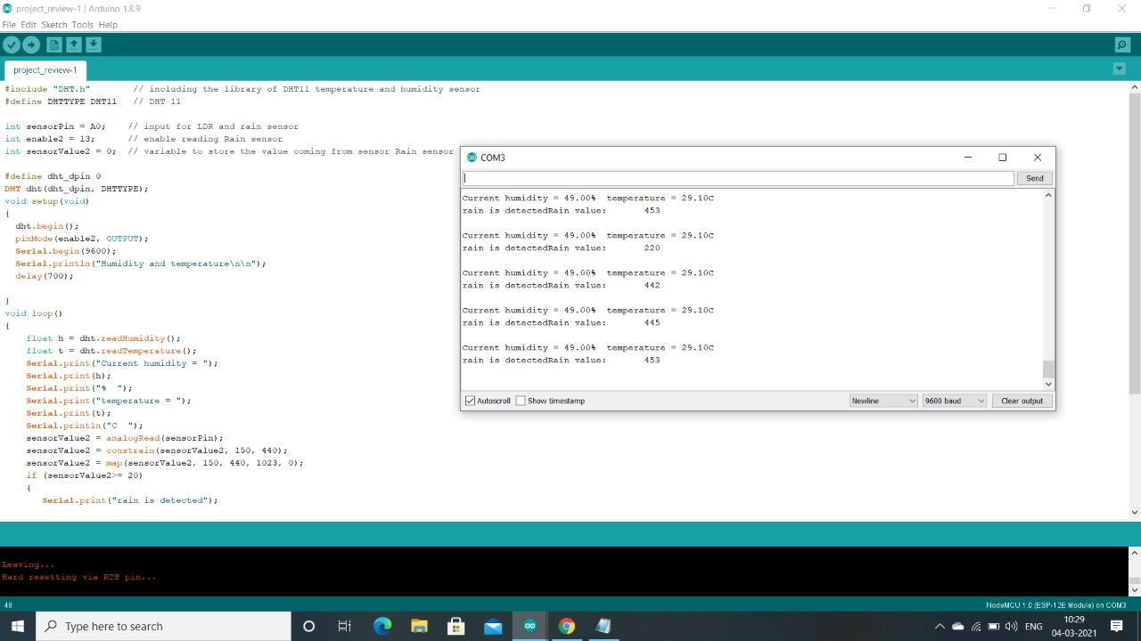
OUTPUT OBSERVED

Slide 25
BLYNK:

Slide 26
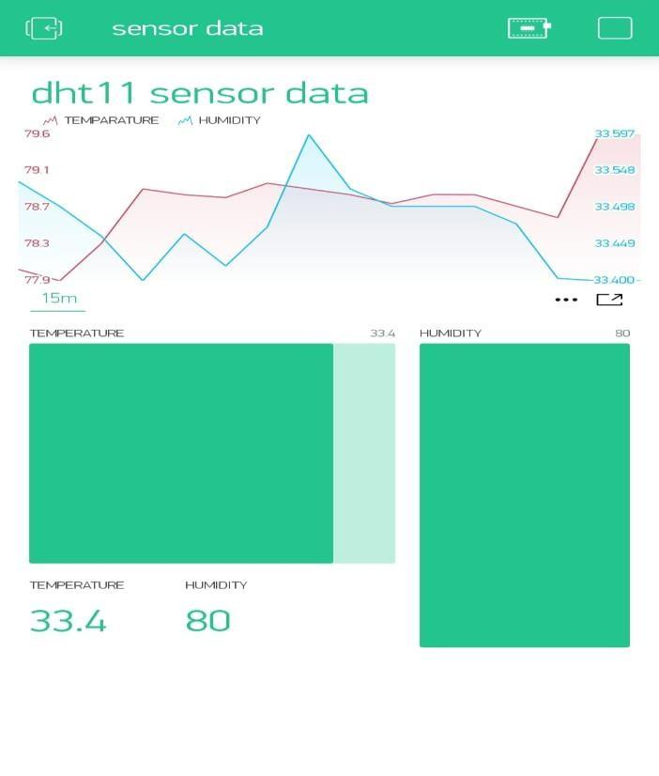
OUTPUT OBSERVED

Slide 27
Weather prediction:

Slide 28
Literature review
Key points observed after making various literature surveys about weather prediction techniques :
A tool was built to parse all weather related information form different websites that stores such information. Data mining and AI algorithms were used for future forecasting based on historical data
https://drive.google.com/file/d/1KCdx_kHzZ2yuVqsMtfW699_A_teP4wMn/view?usp=drivesdk
The proposed system serves as tool that takes in the rainfall data from large amount of data as input and predicts the future rainfall in an efficient manner. Predictive analytic models capture relationships among many factors in a data set to assess risk with particular set of conditions to assign a score or weight. These patterns of score/weight found in historical data can be used to predict future values
https://drive.google.com/file/d/1KSTK_krGEiFQ6VWlycCweJvCkMmLbgpy/view?usp=drivesdk

Slide 29
Some of the machine learning algorithms like Linear regression, Support vector machine, Decision tree algorithm are used of accurate and appropriate prediction future values of weather data.
https://drive.google.com/file/d/1KJOMIp6alb_uPFPaaaIBlQVNsPNIB3vu/view?usp=drivesdk
Linear regression and logistic regression were used to predict the future values of weather data.
https://drive.google.com/file/d/1KgKxu84tikv_HZl84V_m2yH0d_CGBGp2/view?usp=drivesdk

Slide 30
Conclusions and implementation from literature survey
After our literature survey, we found many of them used large amount so that they get accurate predictions.
Machine learning Algorithms like linear regression, logistic regression and Random forest, SVM etc. were used.
Majority of them used temperature and humidity for predictions.

